Slide 1
Simulating Water
Amit Mondal

Slide 2
Challenges from Moana
Mathematicians need to write complicated algorithms to solve the PDE’s that allow for realistic looking water
Difficult things to simulate:
Accurate wave crashing
Blending the water around an object with the rest of the ocean
Conserving energy and angular momentum
To solve these complicated problems, former UCLA math prof. Joseph Teran worked with Alexey Somakhin to develop APIC

Slide 3
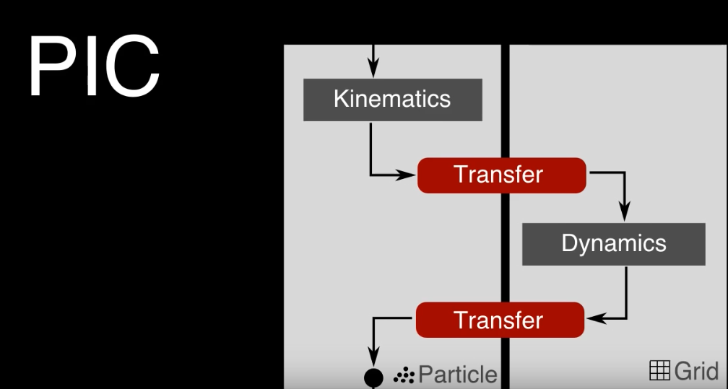
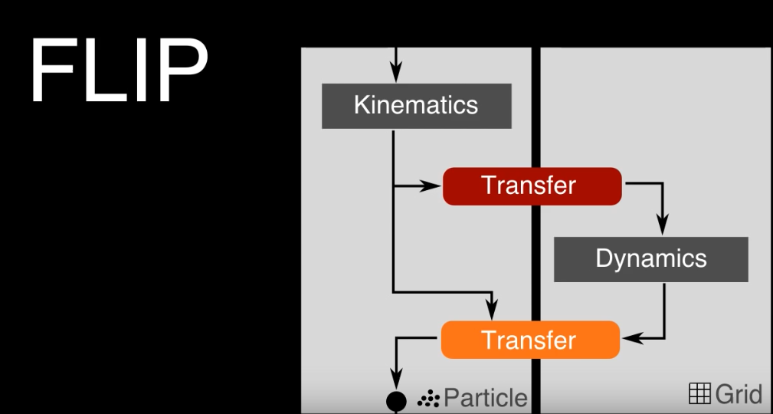
Previous Models
Existing methods:
PIC is a simple method of simulation that transfers between particle representation and cell representation
FLIP acts less as a strict filter than PIC
Uses an incremental update model, to transfer between the grid and particle models

Slide 4
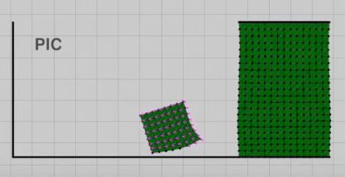
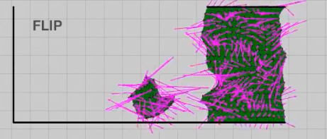
Problems with Previous Modes
PIC
Drops some modes only represented as particles
Results in dissipative simulations, with very damped collisions
FLIP
Fixes PIC’s damping, but leads to instabilities and warpages in the material

Slide 5
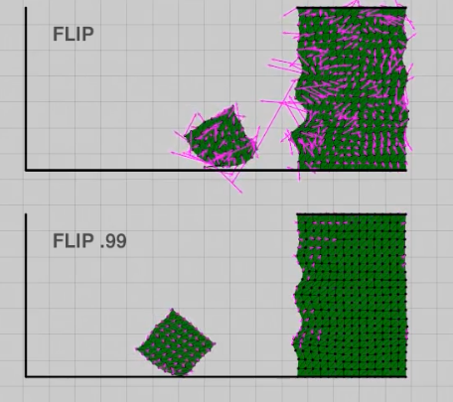
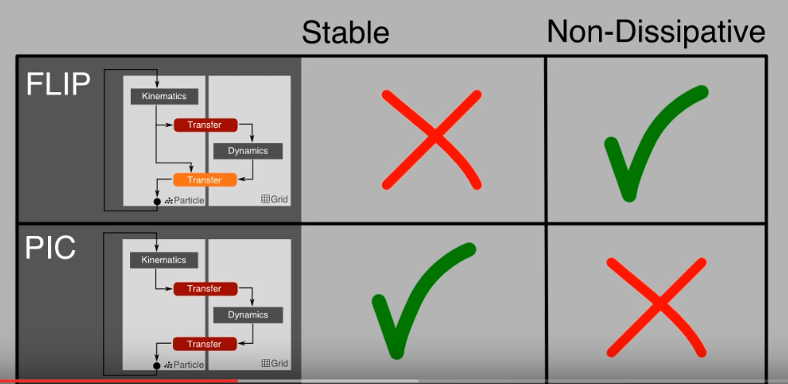
Problems with Previous Modes (Cont’d)
PIC and FLIP are often mixed to try to get the best of both worlds, with mixed results
FLIP preserves rotation, but mixing it with anything else totally destroys rotation

Slide 6
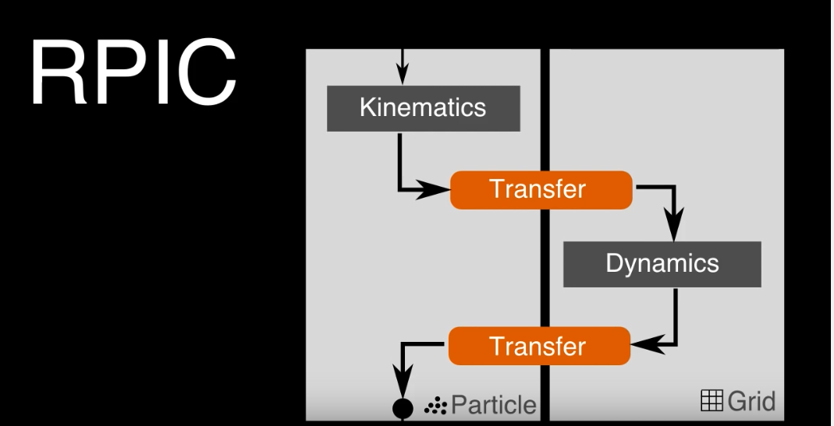
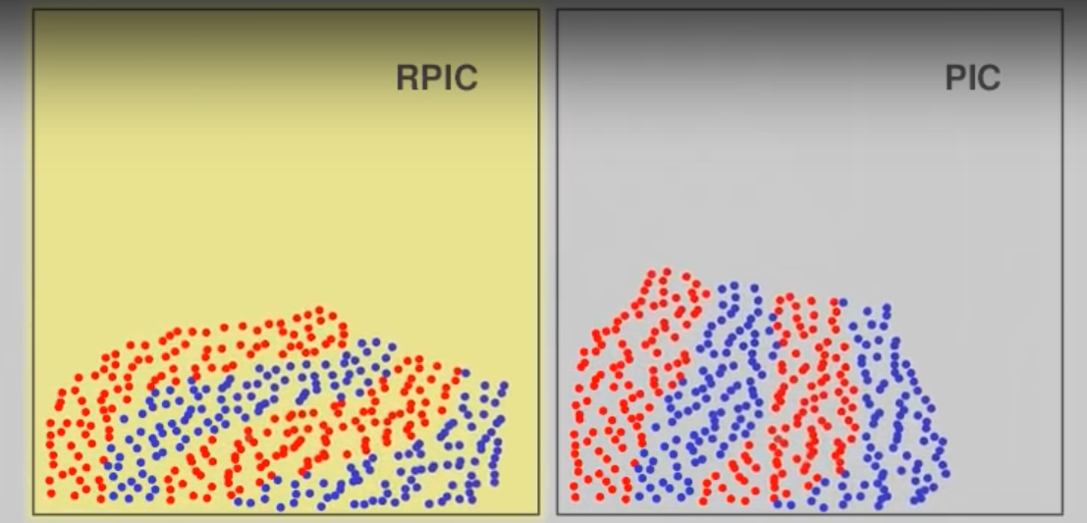
RPIC
Rather than treating each particle motion as locally constant, treat them as locally rigid
Similar to FLIP in that it can preserve rotational motion, but the rigid particles motion means that sheer motion is damped

Slide 7
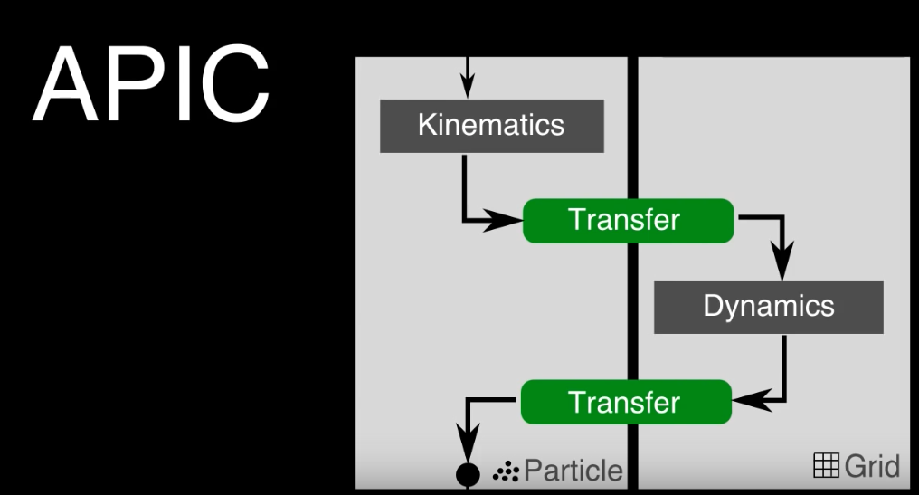
Finally, APIC
APIC – Affine-Particle-In-Cell method
To fix the damped sheer motion from RPIC, particles are treated as locally affine rather than locally rigid
“Affine Transformation is a linear mapping method that preserves points, straight lines, and planes. Sets of parallel lines remain parallel after an affine transformation.”
Perfectly preserves linear momentum and angular momentum

Slide 8
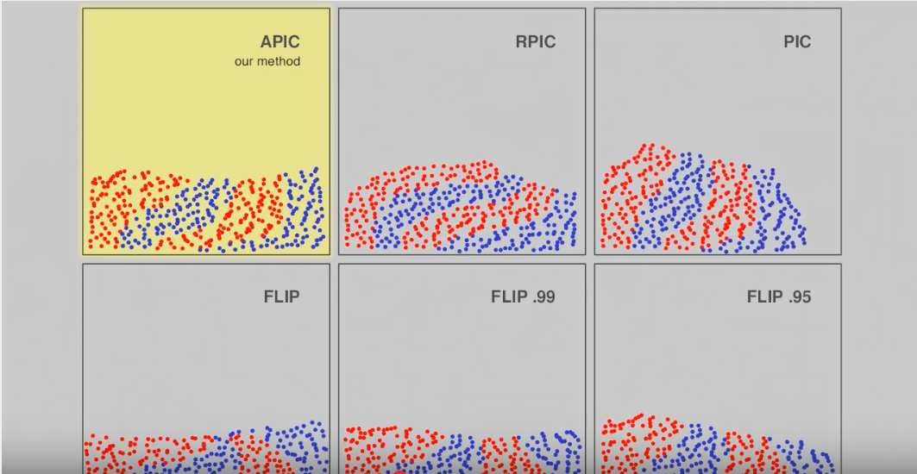
Benefits of APIC
Sheer motion is preserved
Rotation is preserved
More stable than FLIP
Less computationally intensive than PIC

Slide 9
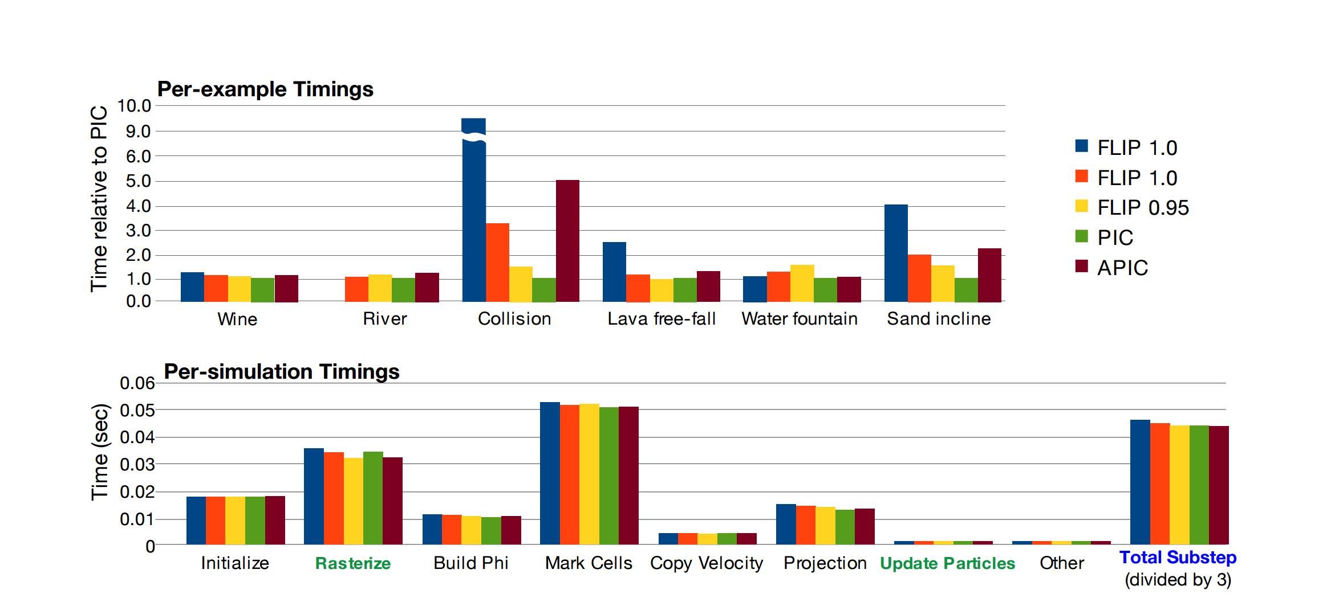
Efficiency of Different Models

Slide 10
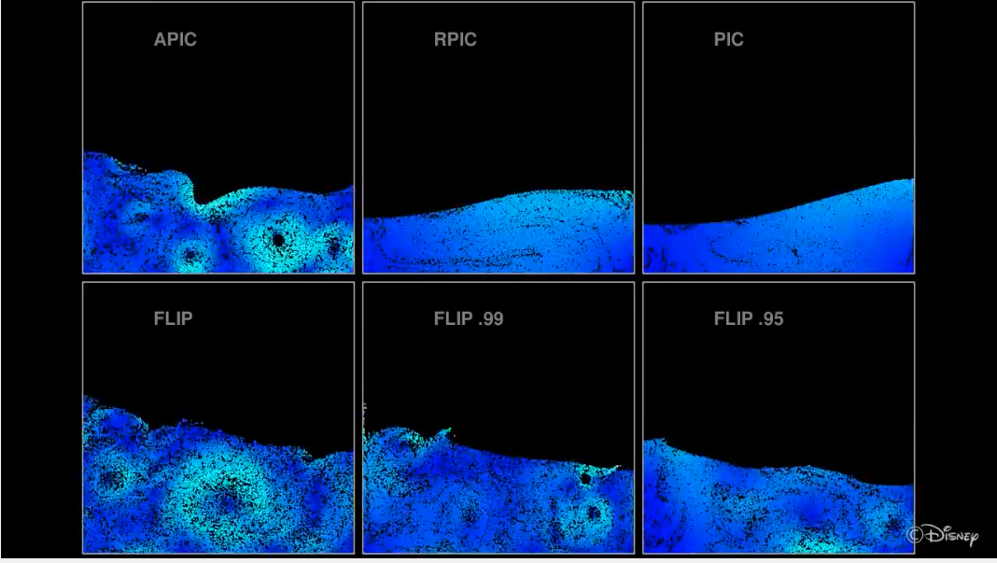
Benefits of APIC (cont’d)
Vorticity is Preserved without FLIP’s unstable motion

Slide 11
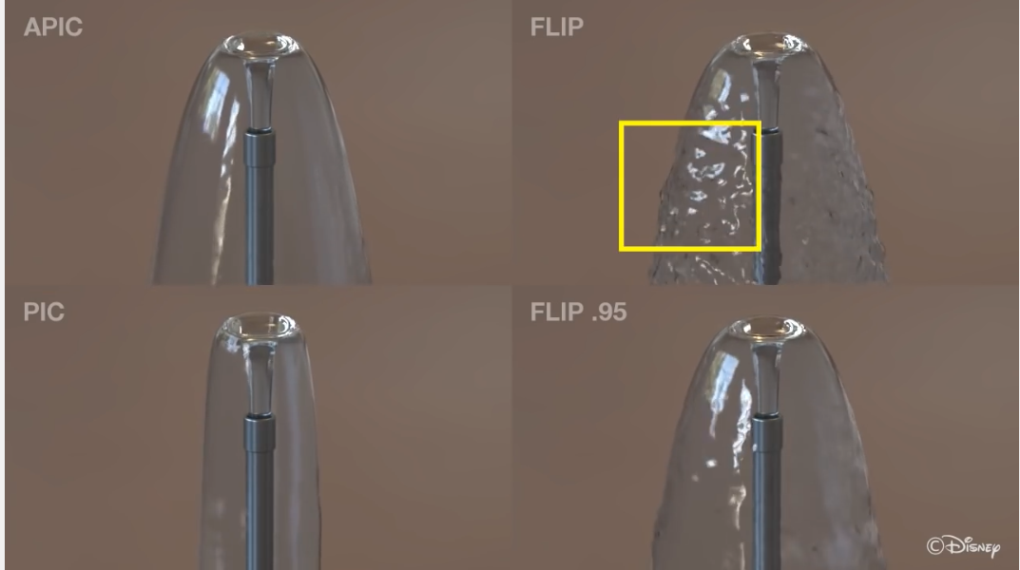
Benefits of APIC (cont’d)

Slide 12
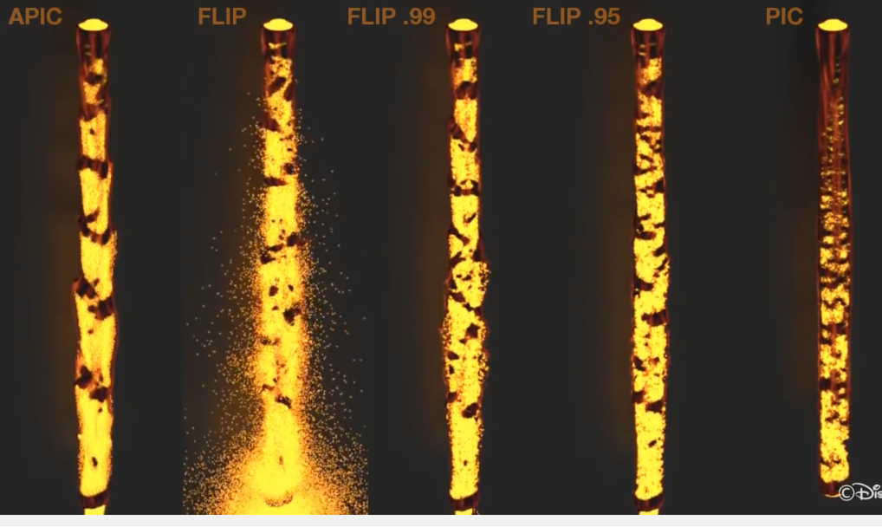
Benefits of APIC (cont’d)

Slide 13
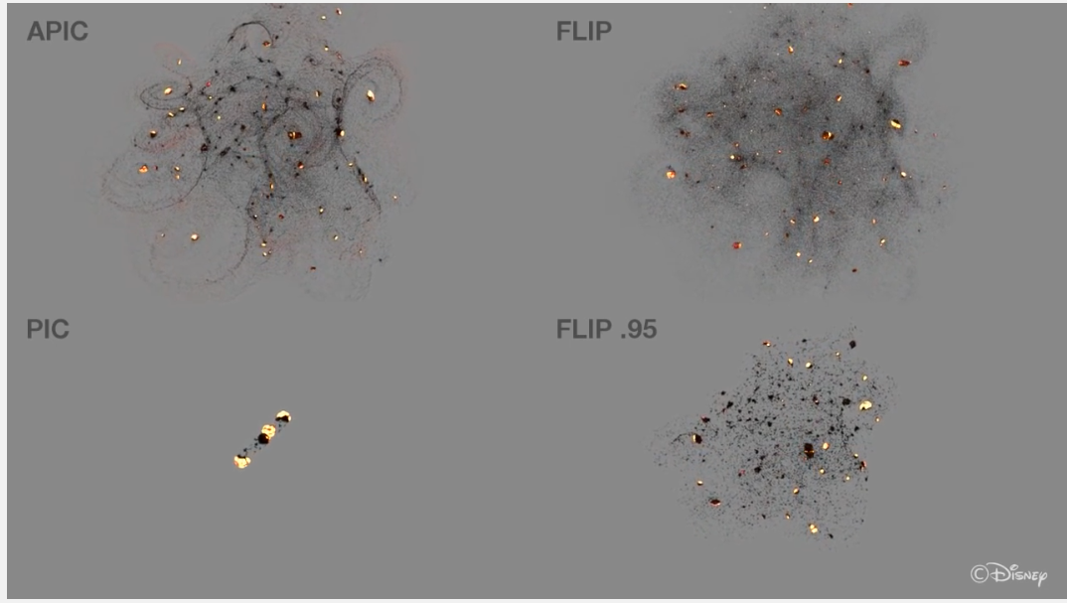
Benefits of APIC (cont’d)
Conservation of Angular momentum benefits

Slide 14
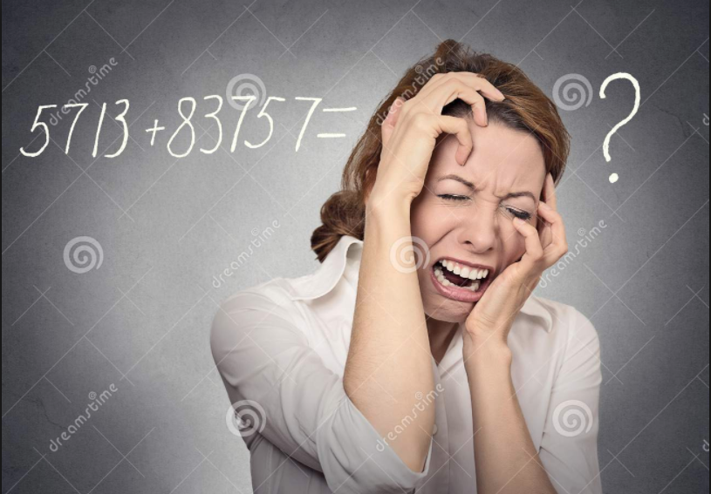
TIME FOR THE MATH

Slide 15
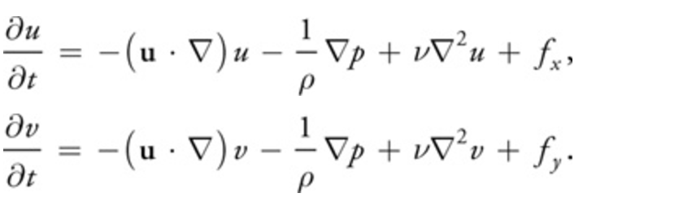
The Basics
The Navier-Stokes equation for incompressible fluid flow
u(x, t) represents the fluid’s velocity field, and p(x, t) represents the fluid’s scalar pressure field

Slide 16
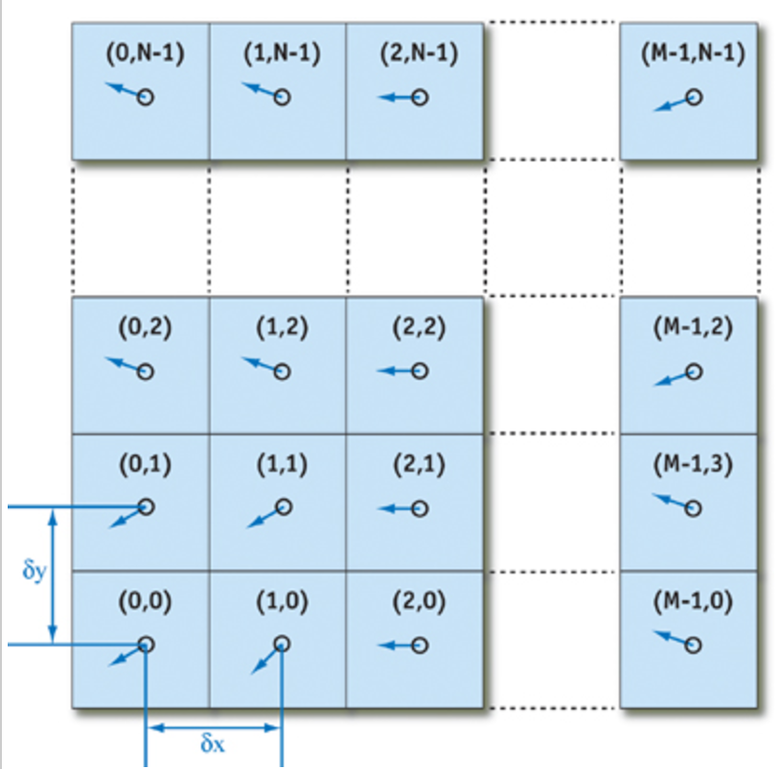
The Basics (cont’d)

Slide 17
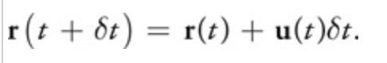
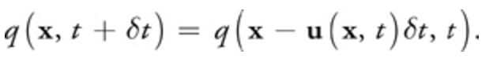
The Basics (cont’d)
Advection – the process by which a fluid’s velocity transports itself and other quantities in the fluid
This is where the particle model for fluids comes in
This method can be generalized and inverted to update any quantity (velocity, density, etc.)

Slide 18
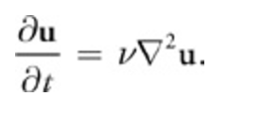
Revenge of the Basics
PDE for viscous diffusion (modelling fluid resistance to allow sand, lava, etc. fluid simulations)

Slide 19
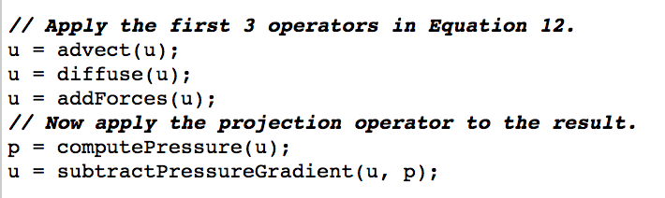
The Basics (cont’d)
Implementation pseudocode
addForces involves solving Poisson equations

Slide 20
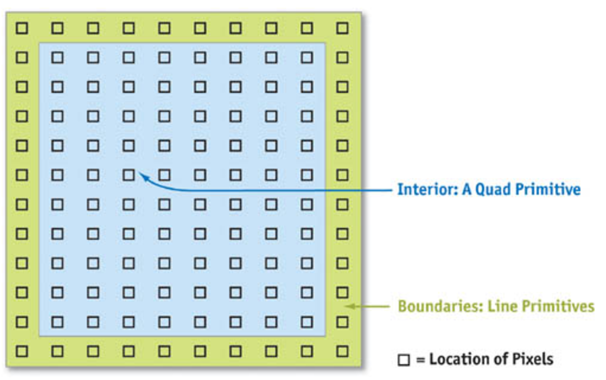
The Basics (cont’d)
The rendering steps are broken up into slab operations (slabops)
Each slabop consists of fragment processing

Slide 21
Works Cited
http://http.developer.nvidia.com/GPUGems/gpugems_ch38.html
https://www.youtube.com/watch?v=rPPW_1M8nRA
https://www.math.ucla.edu/~jteran/papers/JSSTS15.pdf
http://newsroom.ucla.edu/stories/ucla-mathematicians-help-bring-the-ocean-to-life-for-disneys-hit-movie-moana

